Slide 1
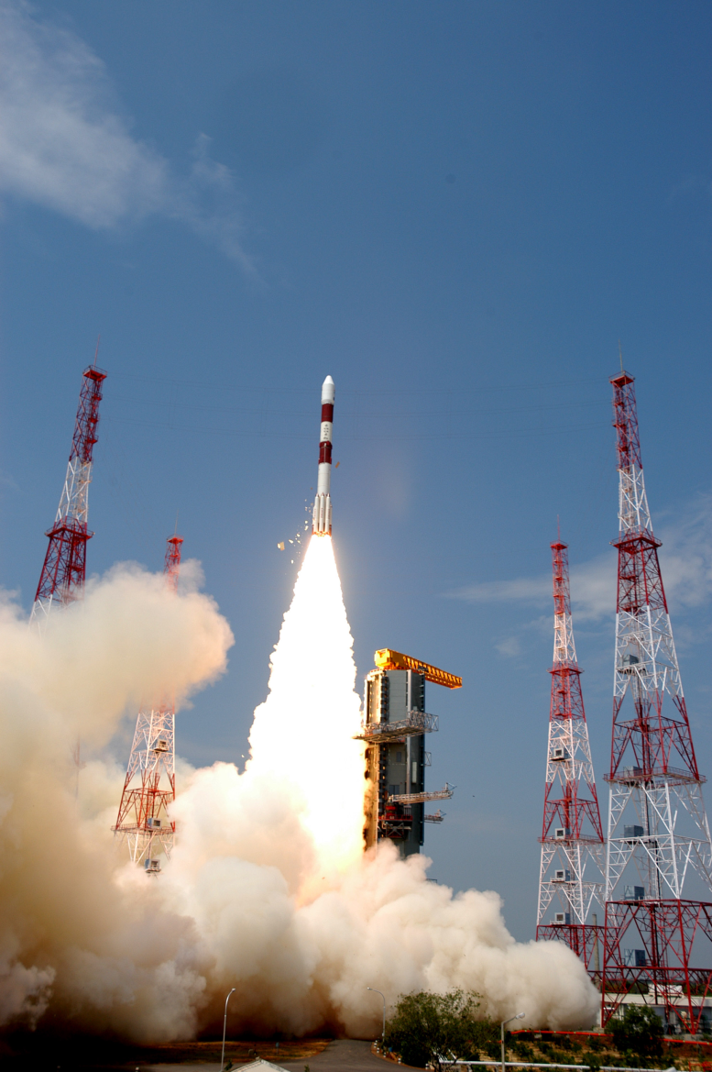
Newton’s 3rd Law

Slide 2
Newton’s 3rd Law
“For every action force there is an equal (in magnitude) and opposite (in direction) reaction force.”
Any interaction involves two forces that we call action-reaction force pairs.

Slide 3
Normal Force
Normal Force: the perpendicular contact force exerted by a surface on another object. For an object on a surface at rest, the normal force must be equal to the force of gravity to maintain equilibrium.
The normal force is the result of the Pauli exclusion principle which states that two or more identical fermions (particles with half-integer spin), e.g. electrons, cannot occupy the same quantum state within a quantum system simultaneously. As a result the electrons of the object and of the surface repel each other, thus holding up the object on the surface.
Here the force of the object on the surface is equal in magnitude and opposite in direction to the force of the surface on the object (Newton’s third law).

Slide 4
Examples:
1) You hit a baseball with a bat.
The bat hits the ball - the ball hits the bat
2) A sprinter starts running.
The sprinter pushes the ground - the ground pushes the sprinter
3) A fish swims through water.
The fish pushes the water backwards - the water pushes the fish forwards

Slide 5
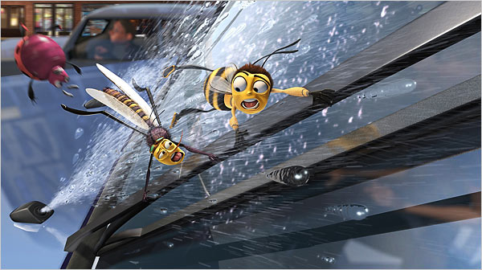
Imagine a bug hitting the windshield of a semi trailer.
What force pair occurs?
Which force is bigger?
Which object has a greater acceleration?
Hands up if you hate Newton!!!
Bug hits truck –
Truck hits bug
NEITHER!!!
Since, a = F_{net}
m
the truck has a much smaller acceleration because it is much, much more massive.

Slide 6
Some other common examples of Newton’s 3rd Law at work include:
1) When firing a gun, the gases push forward on the bullet AND backwards on the gun…

Slide 7
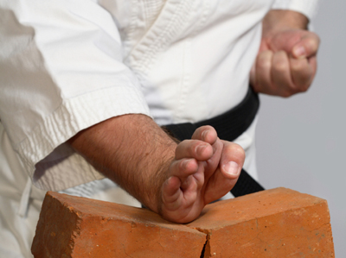
2) While breaking bricks you have to exert enough force to break them all…
or else…

Slide 8

3) When a rocket lifts off, the gasses are pushed out of the back of the rocket, which means…

Slide 9

Tension

Slide 10
Tension occurs within a material that is being pulled or stretched.
It is an internal force that acts at all points along a rope (string, chain, etc) in both directions.

Slide 11
Consider two carts attached by a rope being pulled along a flat surface. (Friction is negligible.)
If m₁ is pulled to the right by a force of 40.0 N find:
The acceleration of the carts.
The tension in the string connecting them.
m₂ = 6.0 kg
m₁ = 4.0 kg

Slide 12
The acceleration can be found using the net force equation for the entire system:
NOTE: tension cancels out of the total F_{net} equation
m₂ = 6.0 kg
m₁ = 4.0 kg

Slide 13
Since it cancels out of the total F_{net} equation, to solve for tension we will only consider the forces acting on one mass.
NOTE: Since tension acts on both masses equally we can use either mass.
m₂ = 6.0 kg
m₁ = 4.0 kg

Slide 14
Consider two equal masses hanging from a pulley.
Diagram the forces acting on the entire system.
With pulley problems it is sometime easier to “unfold” the rope as shown.
m₁
m₂

Slide 15
m₁
m₂
Write the net force equation including ALL forces acting on the system.
Again tension acts in both directions along the rope so it cancels out of the equation.

Slide 16
Ex: The two masses shown hanging from a frictionless pulley are released at rest. Find
The acceleration of the system.
The tension in the string.
6.0 kg
4.0 kg
NOTES:
When solving for acceleration of the whole system we consider m_{total}.
When finding T we only use one mass.

Slide 17
Ex: A mass on a frictionless table is attached to a hanging mass over a frictionless pulley as shown. Find:
The acceleration of the masses.
The tension in the rope.
8.0 kg
6.0 kg

Slide 18
Ex2: If the same system has a friction force of 25 N acting on the 8.0 kg mass find:
The acceleration of the masses.
The tension in the rope.
8.0 kg
6.0 kg

Slide 19
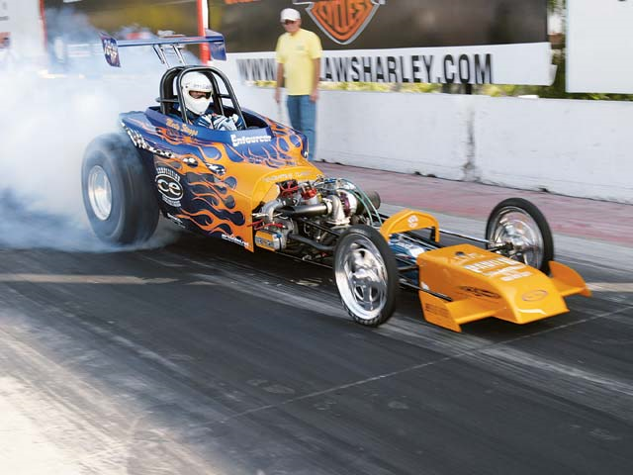
Force of Friction

Slide 20
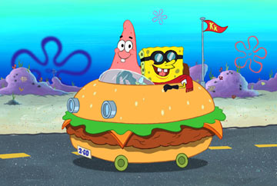
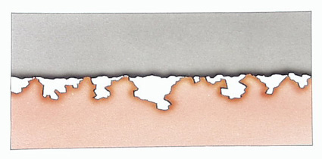
Friction is created whenever two surfaces try to move past one another.
On the microscopic level, irregularities in each surface impede motion, therefore the smoother the surface the less friction.

Slide 21
F_{f} is given by the equation:
Where:
F_{N} = Normal (supporting) force
= ALWAYS perpendicular to surface
μ = Coefficient of friction, no units
= Greek letter “myu”
= depends on BOTH surfaces
F_{f} = μF_{N}

Slide 22
There are two types of friction:
Static Friction: The friction force that must be overcome in order to initially move an object.
Kinetic Friction: The friction force that occurs on an object that is in motion.
Generally:
Friction_{static} > Friction_{kinetic}
μ_{s} > μ_{k}

Slide 23
Ex 1
A 3.75 kg block is pushed along a tabletop with a force of 45.0N. The coefficient of friction is 0.65.
a) Find the force of friction.
b) Find the acceleration.

Slide 24
Ex 2
A 0.200 kg puck is pushed along a sheet of ice with a force of 0.240 N. If it moves at a constant velocity, find the coefficient of friction.

Slide 25
Ex 3
A 1.1 kg textbook is held against a vertical wall with a force of 45 N. What is the coefficient of friction between the book and the wall?

