Slide 1
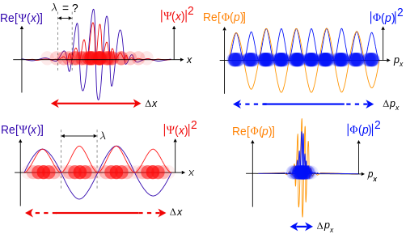
Particle Wave Duality

Slide 2
De Broglie Wavelength
Recall that for light, its momentum is $p=\frac{h}{λ}$. French physicist Louie de Broglie suggested in 1923 that perhaps just as waves can behave like particles, particles can behave like waves. As such a particle can have a wavelength by taking the above expression and equating it to our usual definition of momentum: $mv=\frac{h}{λ}$. Thus
$$λ=\frac{h}{p}=\frac{h}{mv}$$
Where $λ$ is the de Broglie wavelength.

Slide 3
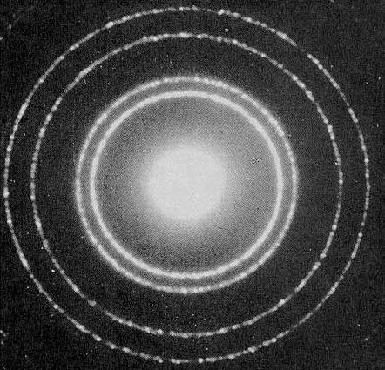
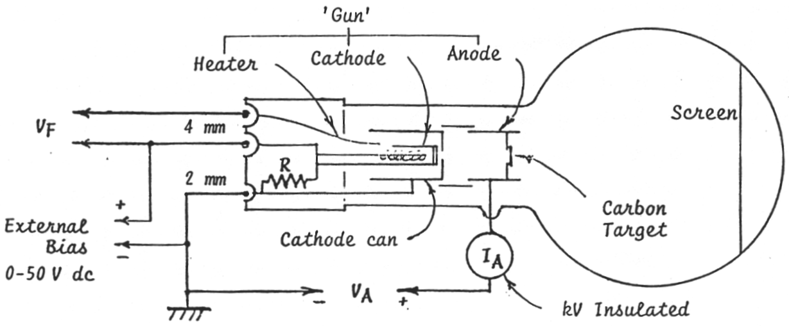
De Broglie’s predictions were shown to be true in the diffraction of electrons.
Why don’t we see diffraction with everyday objects? Well the de Broglie wavelength is just too small. Consider a baseball:
$$λ=\frac{h}{mv}=\frac{6.63×{10}^{−34}Js }{\left(0.145 kg\right)\left(38\frac{m}{s}\right)}=1.2×{10}^{−34}m$$

Slide 4
Example 1
An electron is accelerated to a kinetic energy of $12×{10}^{−18}J$ by two parallel plates. What is its de Broglie wavelength? ($m_{e}=9.11×{10}^{−31}kg$)

Slide 5
Heisenberg Uncertainty Principle
How would you measure an object’s position and speed? You can either touch it or observe it. In the latter case the light would need to reflect off the object in order to be seen. But light can diffract, making it impossible to locate the object’s position.
To decrease the effects of diffraction a shorter wavelength can be used but that results in high energy radiation which can alter the object’s momentum.
Thus trying to lower the uncertainty of the position measurement will increase the uncertainty of the momentum measurement. This is known as the Heisenberg uncertainty principle, after German physicist Werner Heisenberg.

Slide 8
Example 2
During a lab you just measured the position of a moving cart to be 3.0 ± 0.5 cm. A group member says that with that uncertainty their momentum measurement will now have a huge uncertainty because of the Heisenberg uncertainty principle? Is he correct?

Slide 9
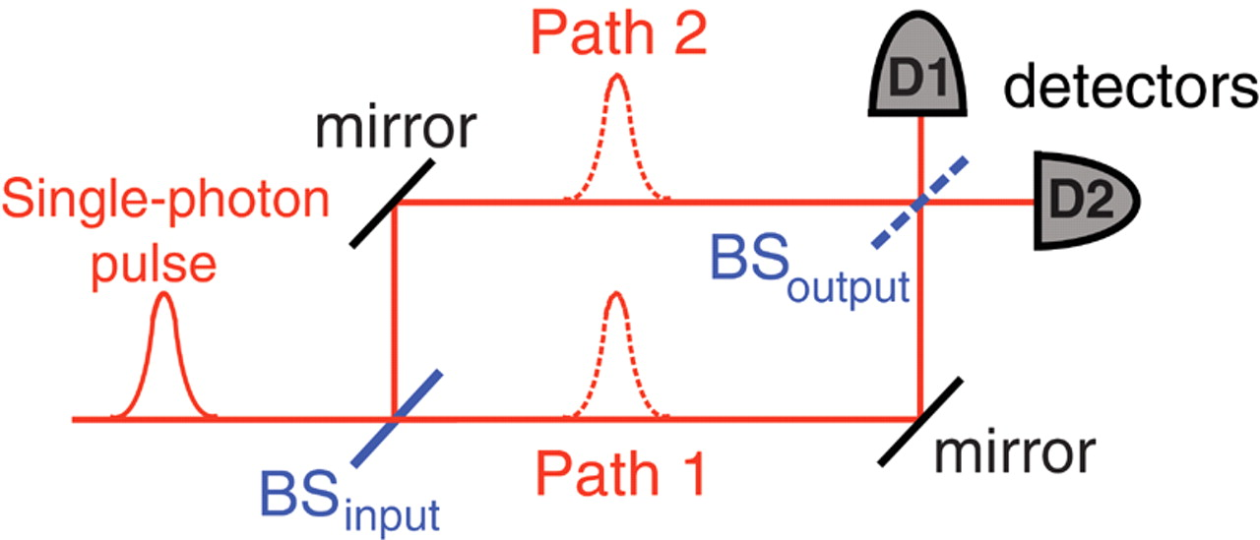
Wheeler’s Delayed Choice Experiment
Proposed by American physicist John Archibald Wheeler in 1978.
Realized by French physicist Alain Aspect et al. in 2007.
BS_{output} is inserted after the photon passes BS_{input}
Particle behaviour observed without BS_{output};
wave behaviour with.
Does the photon decide to be
a wave only once the second
beam splitter is inserted?

