Slide 1
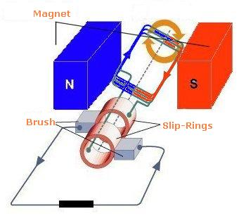
Back EMF

Slide 2
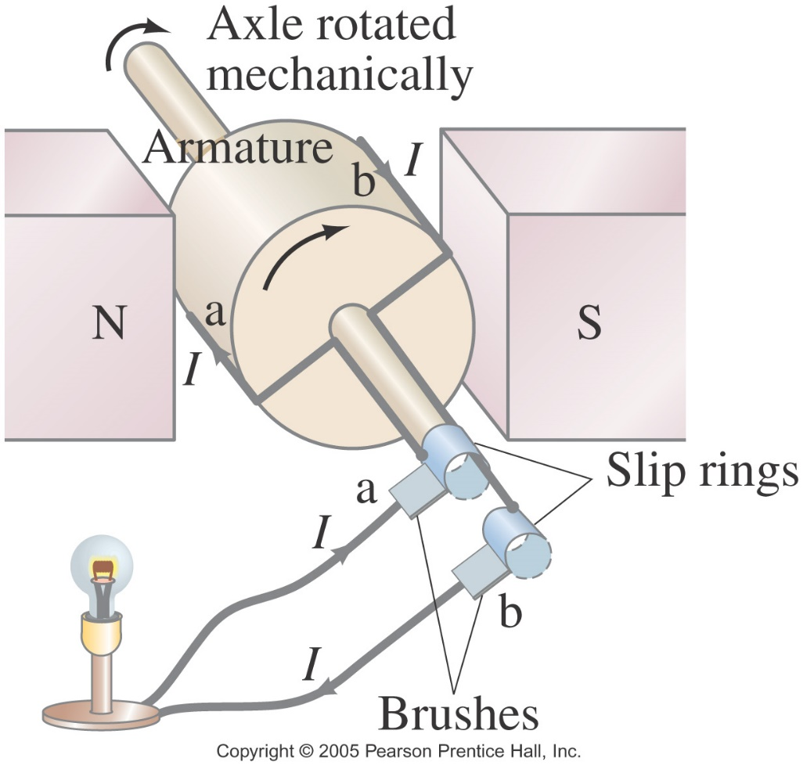
21.5 Electric Generators
A generator is the opposite of a motor – it transforms mechanical energy into electrical energy. This is an ac generator:
The axle is rotated by an external force such as falling water or steam. The brushes are in constant electrical contact with the slip rings.
Alternating current is produced because the direction of the current reverses every half turn.

Slide 3
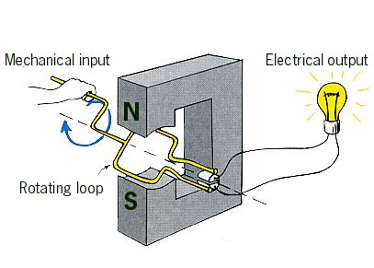
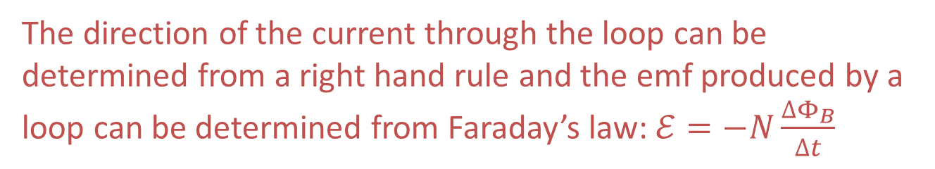
21.5 Electric Generators
The direction of the current through the loop can be determined from a right hand rule and the emf produced by a loop can be determined from Faraday’s law: $ℰ=−N\frac{ΔΦ_{B}}{Δt}$

Slide 4
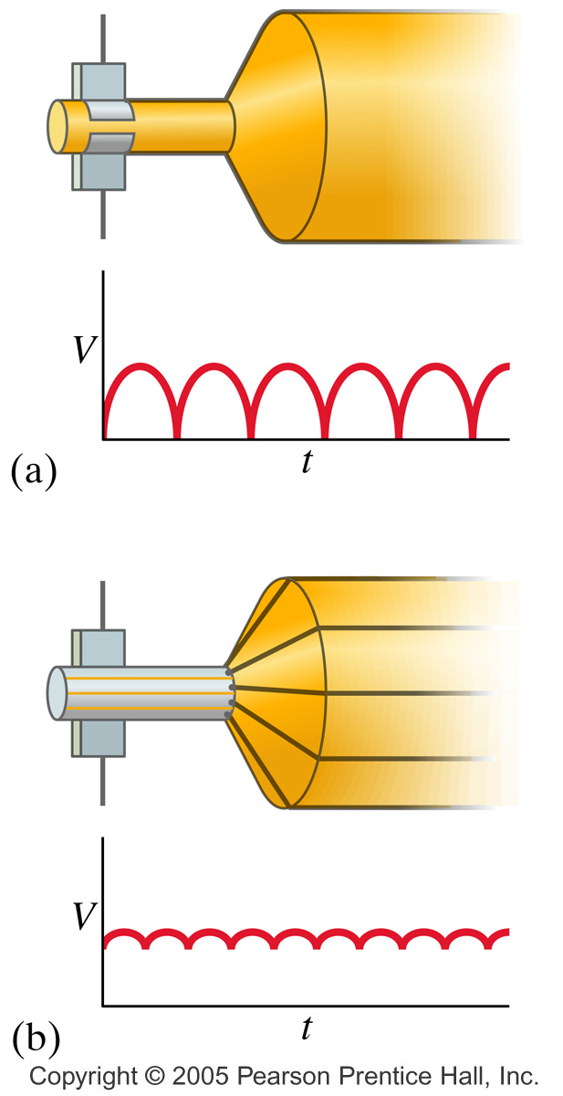
21.5 Electric Generators
A dc generator is similar, except that it has a split-ring commutator instead of slip rings.

Slide 5
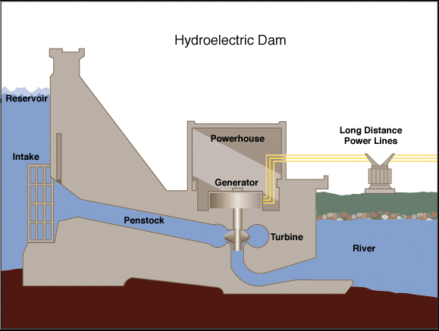
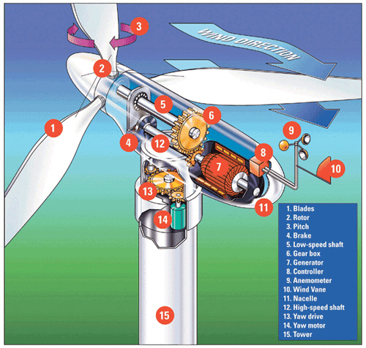
21.5 Electric Generators
Wind turbines and hydro-electric dams are two examples of power sources that use electric generators.

Slide 6
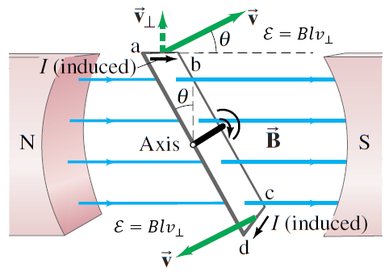

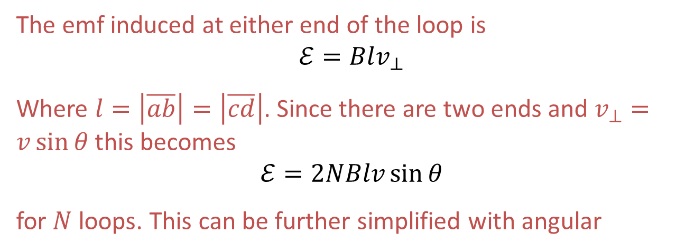
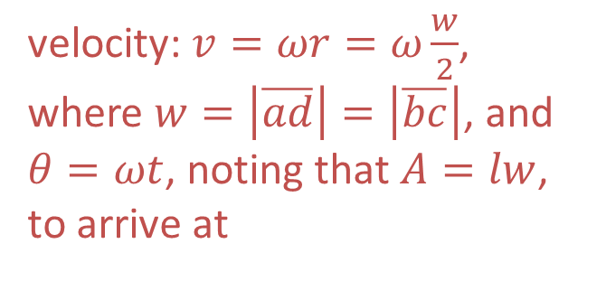
21.5 Electric Generators
The emf induced at either end of the loop is
$$ℰ=Blv_{⊥}$$
Where $l=\left|\overline{ab}\right|=\left|\overline{cd}\right|$. Since there are two ends and $v_{⊥}=v\sin{θ}$ this becomes
$$ℰ=2NBlv\sin{θ}$$
for $N$ loops. This can be further simplified with angular
velocity: $v=ωr=ω\frac{w}{2}$, where $w=\left|\overline{ad}\right|=\left|\overline{bc}\right|$, and $θ=ωt$, noting that $A=lw$, to arrive at
(21-5)

Slide 7
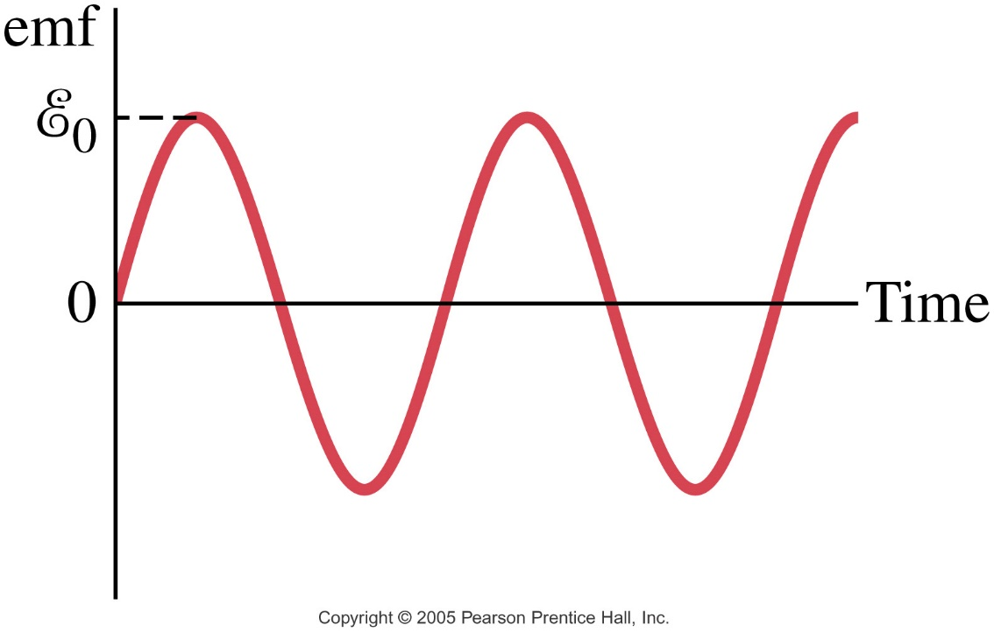

21.5 Electric Generators
A sinusoidal emf is induced in the rotating loop (N is the number of turns, and A the area of the loop):
Remember that $ω=2πf$. So equation (21-5) becomes
$$ℰ=2πNBAf\sin\left(2πft\right)$$

Slide 8
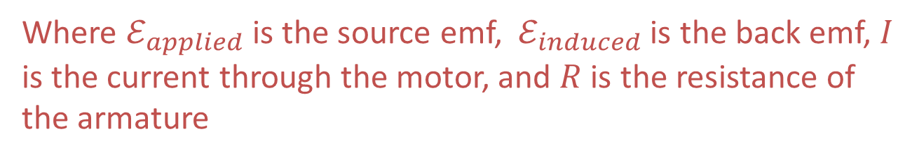

21.6 Back EMF and Counter Torque; Eddy Currents
Electric motors are coils of wire rotating in a magnetic field. When wires are rotated in a magnetic field an electric potential is generated. The induced emf works in the opposite direction by Lenz’s law.
This is called back emf or counter emf, and it always works against the applied emf.
$$ℰ_{applied}−ℰ_{induced}=IR$$
Where $ℰ_{applied}$ is the source emf, $ℰ_{induced}$ is the back emf, $I$ is the current through the motor, and $R$ is the resistance of the armature

Slide 9
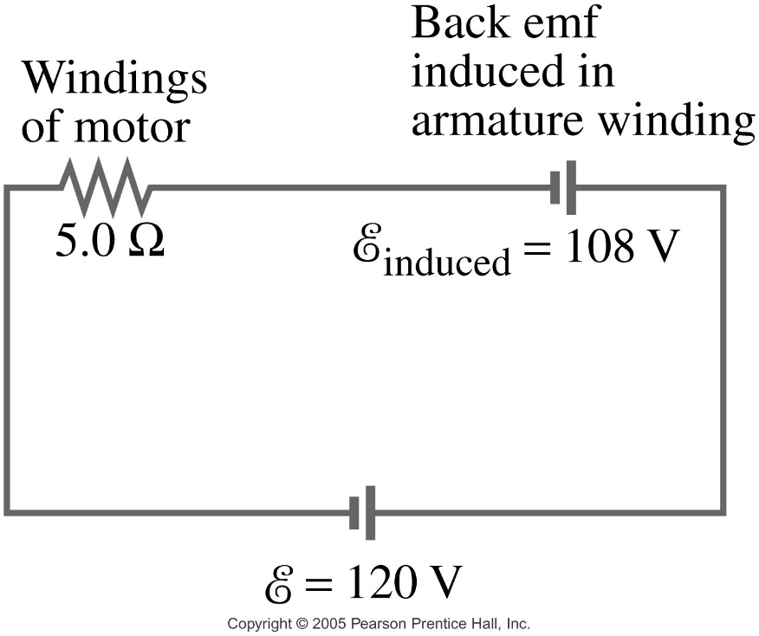
21.6 Back EMF and Counter Torque; Eddy Currents
An electric motor turns because there is a torque on it due to the current. The motor would accelerate unless there is some sort of drag torque.
The drag torque in this case is due to the induced back emf.

Slide 10
21.6 Back EMF and Counter Torque; Eddy Currents
A similar effect occurs in a generator – if it is connected to a circuit, current will flow in it, and will produce a counter torque. This means the external applied torque must increase to keep the generator turning.

Slide 11
21.6 Back EMF and Counter Torque; Eddy Currents
Ex. 1) A 120 V motor draws 12 A when operating at full speed. The armature has a resistance of 6.0 Ω.
  Find the current when the motor is initially turned on.
  Find the back emf when the motor reaches full speed.

Slide 12
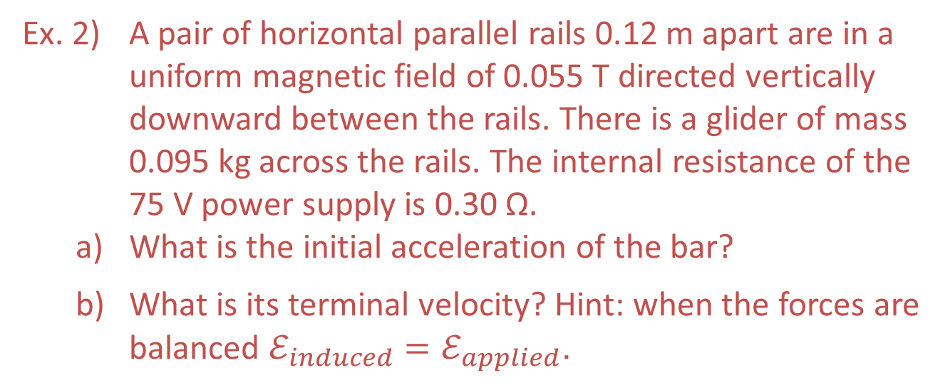
21.6 Back EMF and Counter Torque; Eddy Currents
Ex. 2) A pair of horizontal parallel rails 0.12 m apart are in a uniform magnetic field of 0.055 T directed vertically downward between the rails. There is a glider of mass 0.095 kg across the rails. The internal resistance of the 75 V power supply is 0.30 Ω.
  What is the initial acceleration of the bar?
  What is its terminal velocity? Hint: when the forces are balanced $ℰ_{induced}=ℰ_{applied}$.

Slide 13
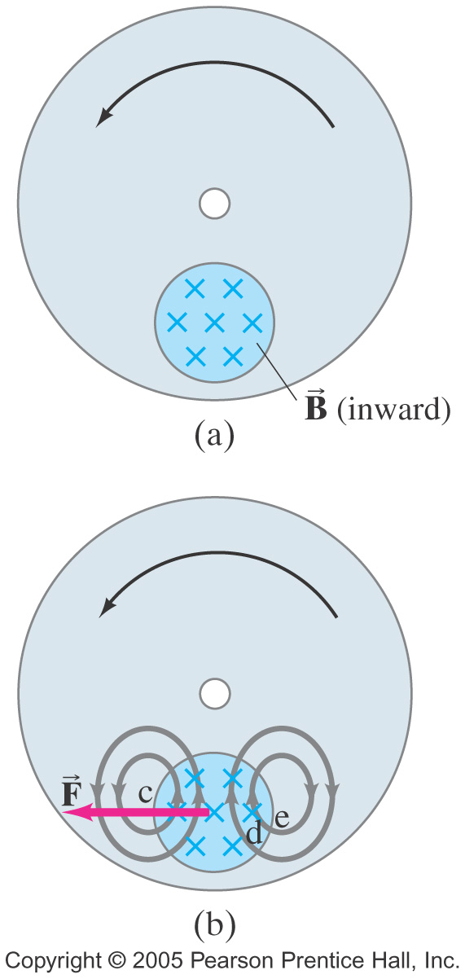
21.6 Back EMF and Counter Torque; Eddy Currents
Induced currents can flow in bulk material as well as through wires. These are called eddy currents, and can dramatically slow a conductor moving into or out of a magnetic field.
Airport metal detectors and anti-theft systems used by stores and libraries detect the magnetic fields caused by eddy currents in metal objects which are themselves caused by very brief pulses of magnetic field created by coils in the walls of the device.

