Slide 1
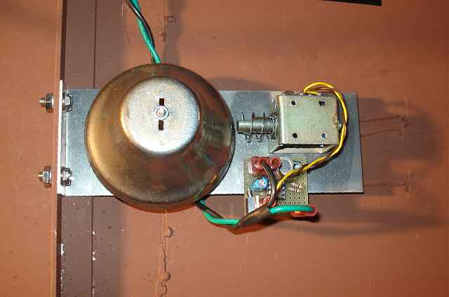
Wires and Solenoids

Slide 2
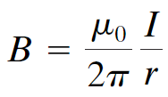
20.5 Magnetic Field Due to a Long Straight Wire
The field is inversely proportional to the distance from the wire:
(20-6)
The constant μ₀ is called the permeability of free space, and has the value:

Slide 3
20.5 Magnetic Field Due to a Long Straight Wire
Ex. 1) Two parallel straight wires 10.0 cm apart carry currents in opposite directions. Current I₁ = 5.0 A is out of the page and, current I₂ = 7.0 A is into the page. Determine the magnitude and direction of the magnetic field halfway between the two wires. Remember B is a vector – the total field is the vector sum of the two fields at the midway point.

Slide 4
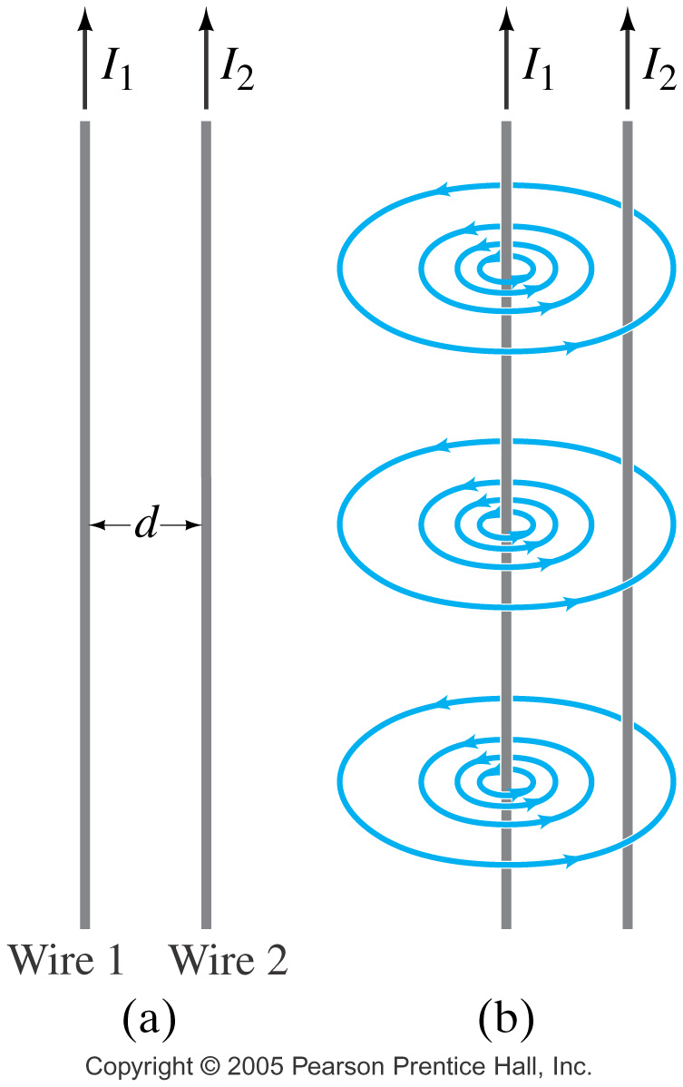
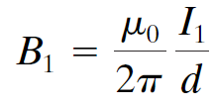
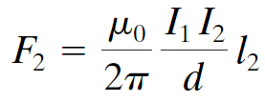
20.6 Force between Two Parallel Wires
The magnetic field produced at the position of wire 2 due to the current in wire 1 is:
The force this field exerts on a length l₂ of wire 2 is:
(20-7)

Slide 5
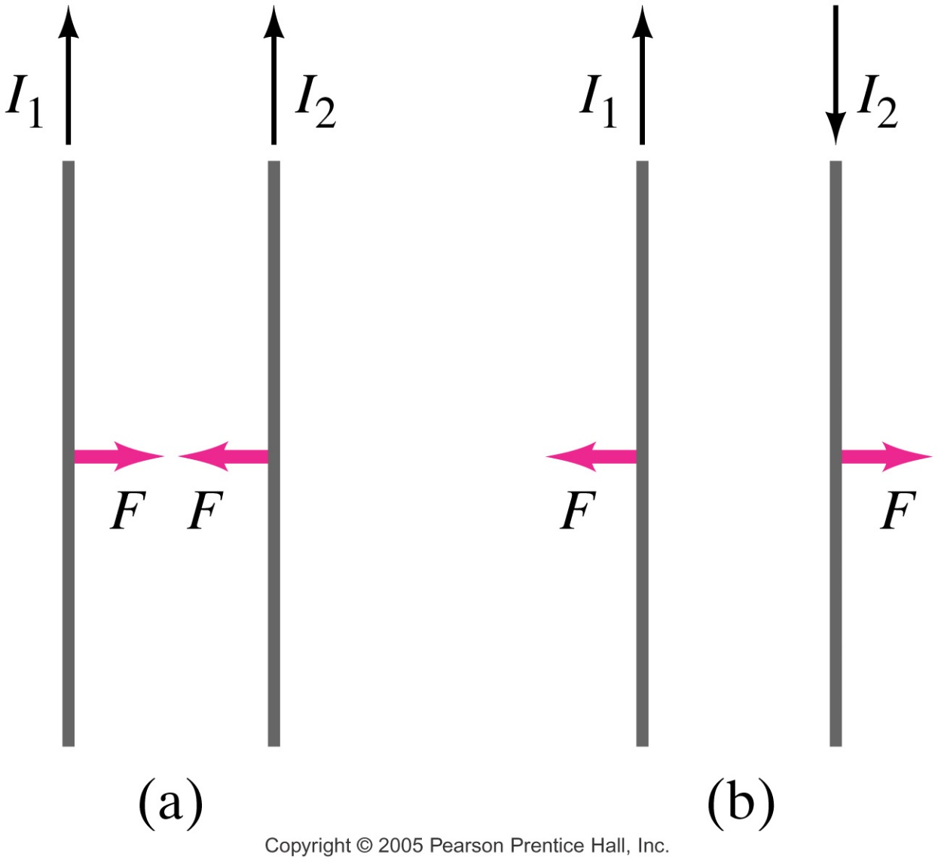
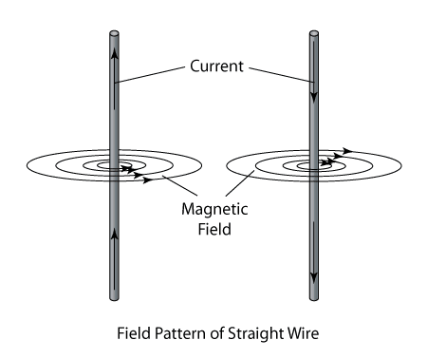
20.6 Force between Two Parallel Wires
Parallel currents attract; antiparallel currents repel. The right-hand rule shows this.

Slide 6
20.6 Force between Two Parallel Wires
Ex. 2) Two wires of a 2.0 m long appliance cord are 3.0 mm apart and carry a current of 8.0 A dc. Calculate the force one wire exerts on the other.

Slide 7
20.6 Force between Two Parallel Wires
Ex. 3) A suspended horizontal wire carries a current I₁ = 80 A dc. A second parallel wire 20 cm below it must carry how much current I₂ so that it doesn’t fall due to gravity? The lower wire has a linear density of 0.12 g/m.

Slide 8
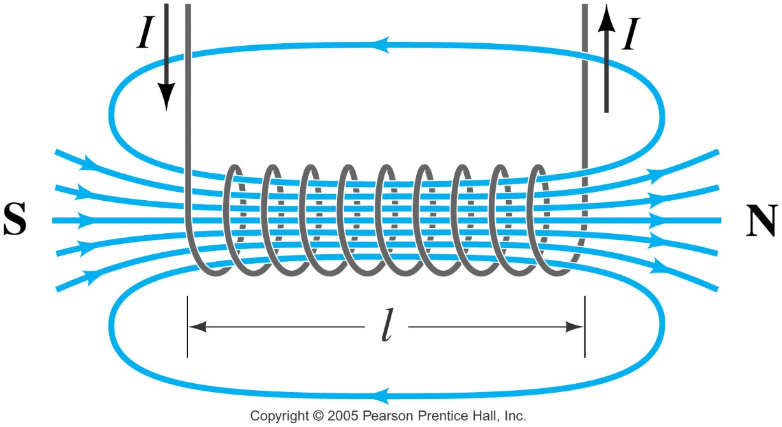
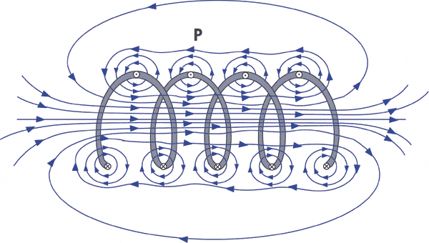
20.7 Solenoids and Electromagnets
A solenoid is a long coil of wire. If it is tightly wrapped, the magnetic field in its interior is almost uniform:
(20-8)

Slide 9
20.7 Solenoids and Electromagnets
If a piece of iron is inserted in the solenoid, the magnetic field greatly increases. Such electromagnets have many practical applications.

