Slide 1
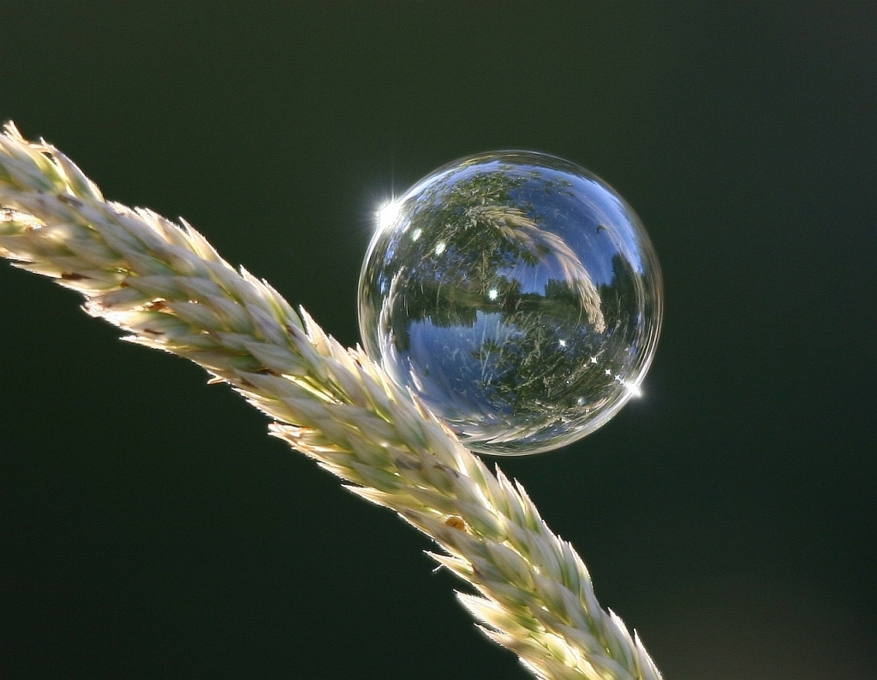
Refraction

Slide 2
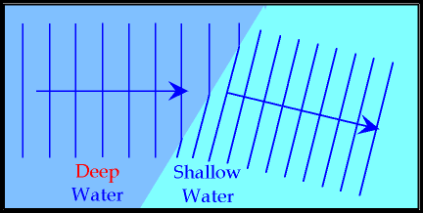
Wave speed depends on the media. What happens when waves travel from one medium into another?
Consider some waves moving from the open ocean to shore. As the water gets more and more shallow, the waves slow down (velocity decreases).

Slide 3
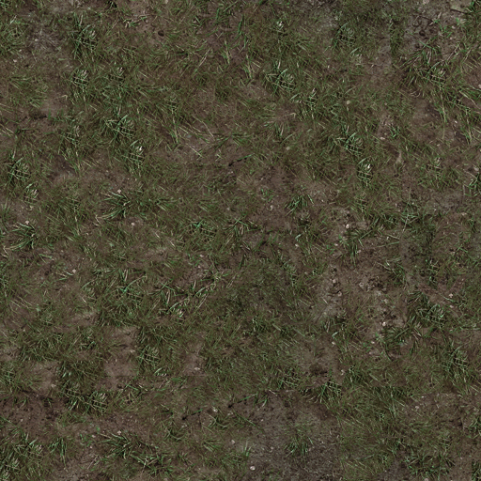
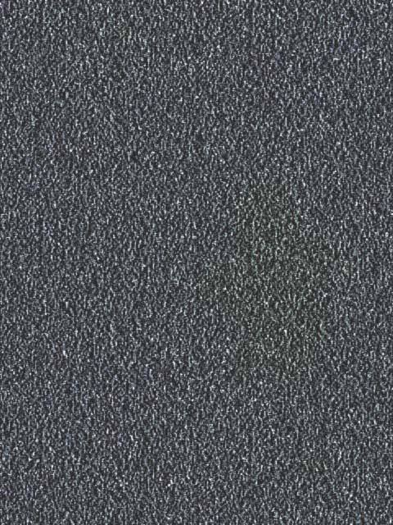
Waves traveling perpendicular to the new medium (Ɵ_{i}= 0º) continue in the same direction.
  Velocity decreases, but frequency stays constant
  Therefore wavelength decreases
When waves are not perpendicular they will also bend.

Slide 4
Since the velocities of the wheels in the two media are different, their path changes.
Refraction: The bending of waves as they move from one medium into another.
Optical density: the difficulty light has in transmitting through a medium.
(vacuum < air < water < glass < diamond)

Slide 5
Consider a laser shining into a piece of quartz:
Angle of Incidence: angle between the normal and the incident ray.
Angle of Refraction: angle between the normal and the refracted ray.

Slide 6
Snells’ Law:
Where:
n = the index of refraction (related to optical density)
Ө_{i} = the angle of incidence
Ө_{r} = the angle of refraction
n_{i}sinӨ_{i} = n_{r}sinӨ_{r}

Slide 7
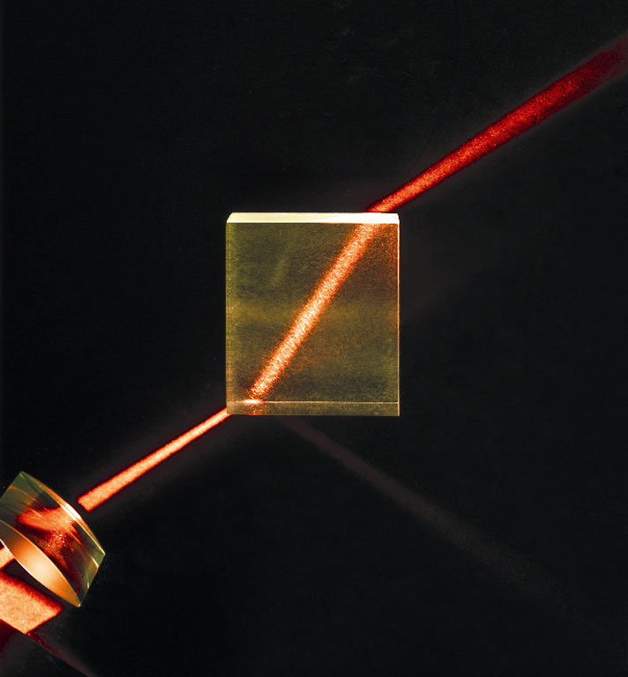
When light travels from:
less dense to more dense
it slows down and
bends towards
the normal
more dense to less dense
medium it speeds up and
bend away from
the normal.

Slide 8
Sample indices of refraction:
Medium | n | Medium | n
vacuum | 1.0000000 | crown glass | 1.52
air | 1.0003 | quartz | 1.54
water | 1.33 | flint glass | 1.61
ethanol | 1.36 | diamond | 2.42

Slide 9
Example
A ray of light traveling in air strikes a block of quartz at a angle of 15º. Find the angle of refraction. Draw a diagram.

Slide 10
Example
A ray of light travels from underwater into air. It travels in the air at an angle of 65º, find the incident angle. Draw a diagram.

Slide 11
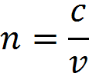
The index of refraction for any substance is:
Where:
n = index of refraction
c = speed of light in a vacuum (3.00x10⁸ m/s)
v = speed of light in the substance

Slide 12
Example
What is the speed of light in water?

Slide 13
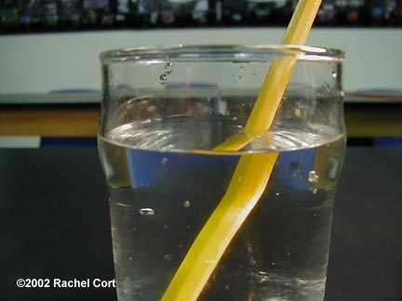

Slide 14
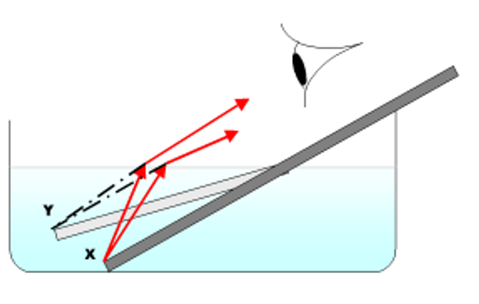

Slide 15
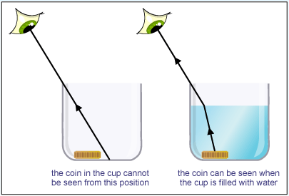

Slide 16


Slide 17
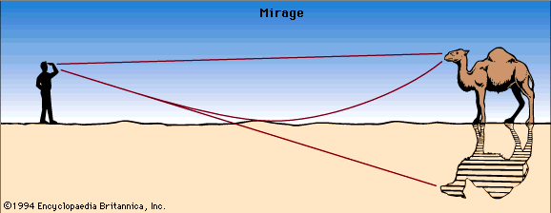

Slide 18
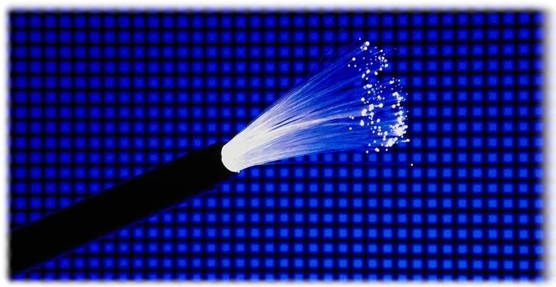
Total Internal Reflection and Critical Angles

Slide 19
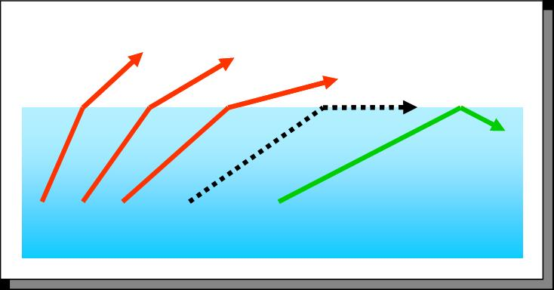
When passing from a more dense to a less dense medium, light refracts away from the normal.
If the angle of incidence is large enough then the angle of refraction will be parallel to the medium boundary (i.e. Ө_{r} = 90º).

Slide 20
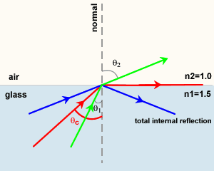

Critical Angle: the incident angle that gives a refracted angle of 90º.
Total Internal Reflection: occurs when the incident angle is greater than critical.
$$\sin{θ_{c}}=\frac{n_{2}}{n_{1}}$$

Slide 21
Example
Find the critical angle for light travelling from water into air. Draw a diagram.

