Slide 1
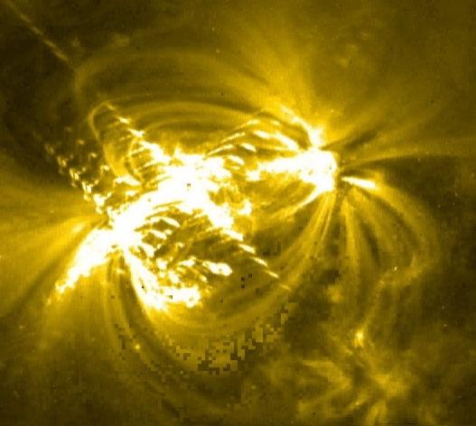
Waves and Light

Slide 2
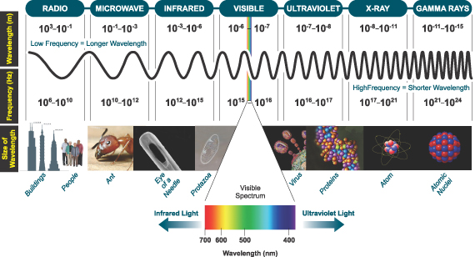
Light is a form of electromagnetic radiation that includes:

Slide 3
EM Radiation
Transverse waves of energy
The speed of light depends on its medium (more dense → slower)
The speed of light (in a vacuum)
c = 3.00x10⁸ m/s
This is the universal speed limit…
nothing can go faster than light

Slide 4
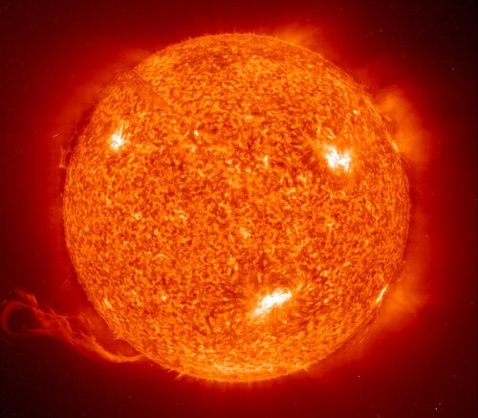
Ok try these…
The Sun is 1.50x10⁸ km from Earth. How long does it take for the light from the Sun to reach us?
Alpha Centauri is the nearest solar system to ours, at 4.07x10¹³ km away. How long does it take for light to travel from Alpha Centauri to us?

Slide 5
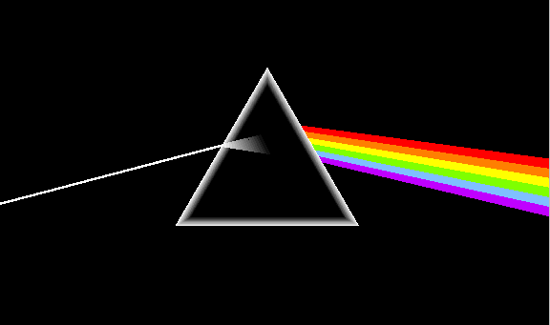
White light is actually a mixture of many different colours (ROY G BIV)
Different colours of light have different wavelengths and frequencies. Red has the longest λ and violet the shortest λ.

Slide 6
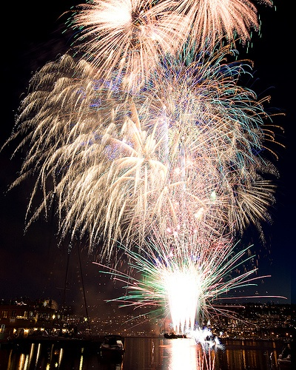
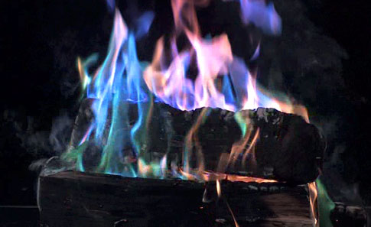
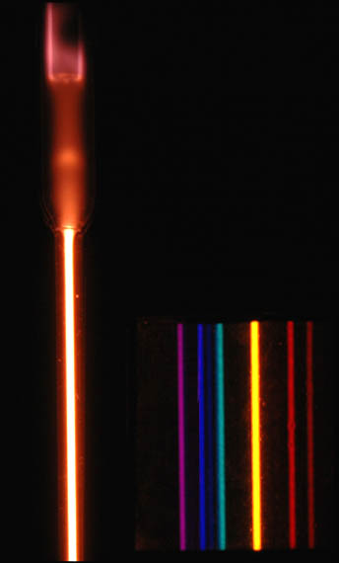
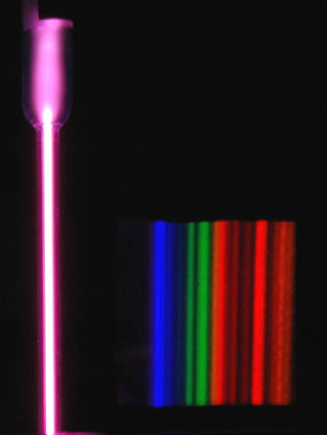
EM Radiation is emitted from energized matter
After energy is absorbed by matter, it is emitted as EM Radiation.
Each element emits very specific frequencies (colours) of light called atomic spectra.
Helium
Argon

Slide 7
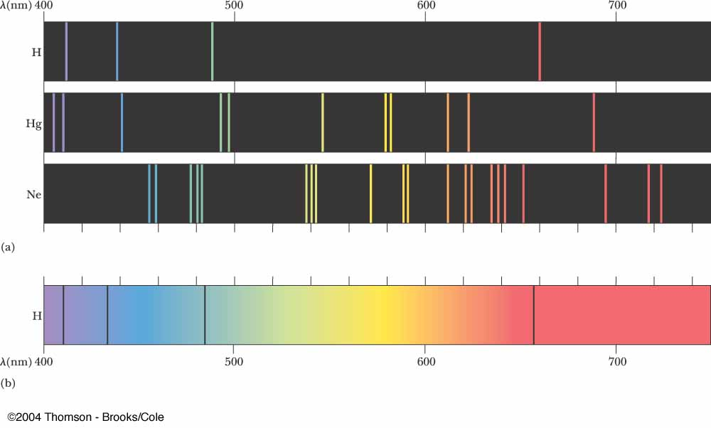
EM Radiation is emitted from energized matter
Hydrogen
Mercury
Neon
Black Body

Slide 8
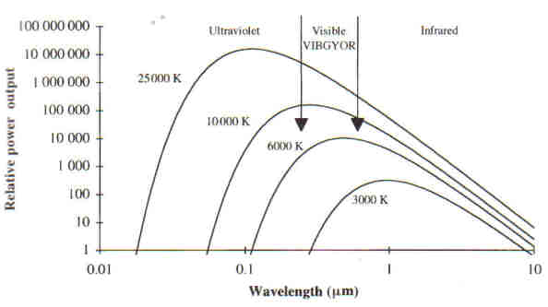
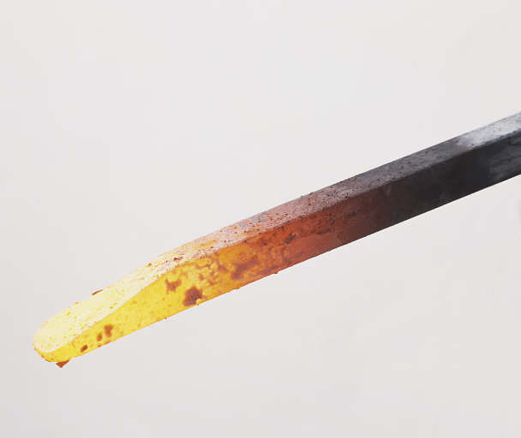
EM Radiation is emitted from energized matter

Slide 9
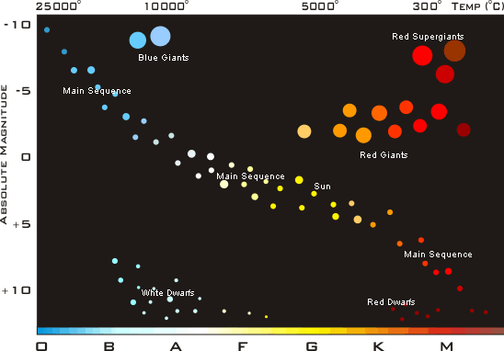
EM Radiation is emitted from energized matter

Slide 10
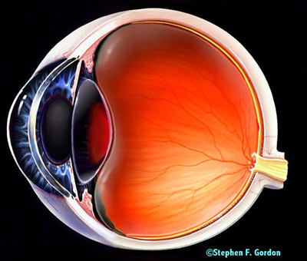
How We See...
White light
Red light Reflected
All other λ absorbed

Slide 11
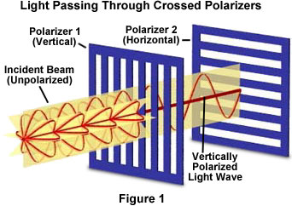
Polarization
The filtration of light so that it only travels in one plane.
Light is a transverse wave. Normal light is unpolarized so it travels in all planes.

Slide 12
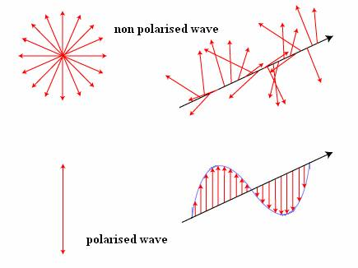

Slide 13
The Doppler effect and Red Shift

Slide 14
The Doppler Effect and Light
$f_{d}=f_{s}\left(1+\frac{v_{s}}{c}\right)$ towards each other
$f_{d}=f_{s}\left(1−\frac{v_{s}}{c}\right)$ away from each other
$Δλ=λ_{d}−λ_{s}=−\frac{v}{c}λ_{s}$ towards each other
$Δλ=λ_{d}−λ_{s}=\frac{v}{c}λ_{s}$ away from each other

