Slide 1
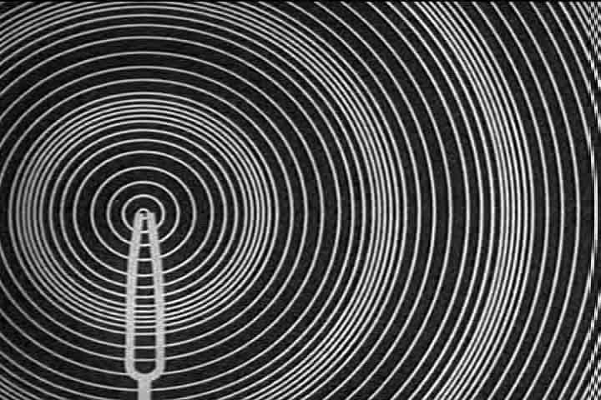
Waves and Sound

Slide 2
Sound
Longitudinal waves of pressure that stimulate our ear drums
The speed of sound depends on its medium (more dense → faster)
Pitch is determined by frequency
Volume is determined by amplitude

Slide 3
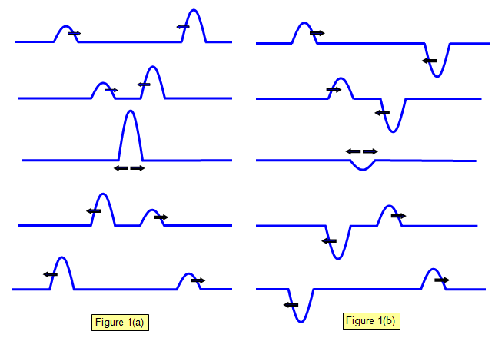
Superposition of Waves
The displacement of a medium caused by two or more waves is the sum of the displacements of the individual waves.

Slide 4
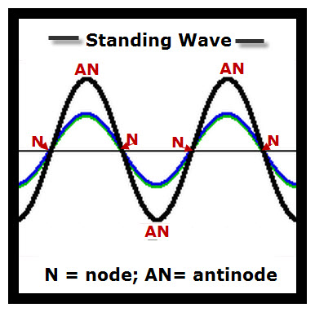
Constructive interference: when two wave pulses add to form a larger wave pulse.
Destructive interference: when two wave pulses cancel each other out.
Node: a point where the medium remains undisturbed by incoming pulses.
Antinode: a point where the
maximum constructive
interference occurs from
incoming pulses.

Slide 5
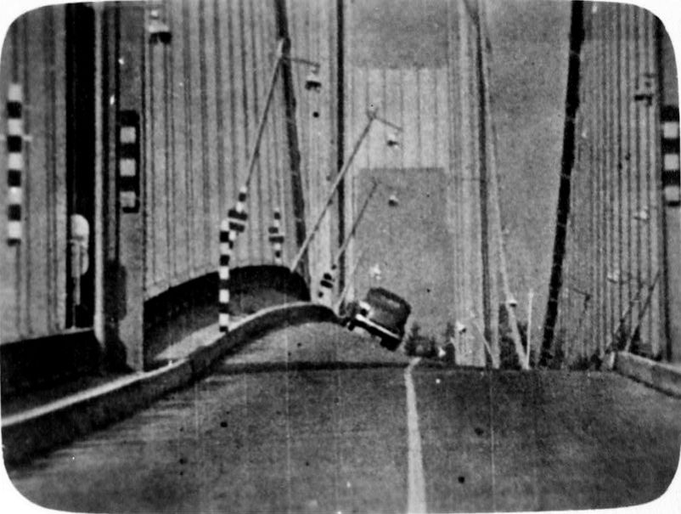
Resonance and Standing Waves
Resonance: When a wave reflects back in such a way that its reflecting wave interferes constructively with the incident wave to form an apparently standing wave.
The frequency this occurs at is known as the natural frequency.
E.g. Tacoma Narrows Bridge

Slide 6
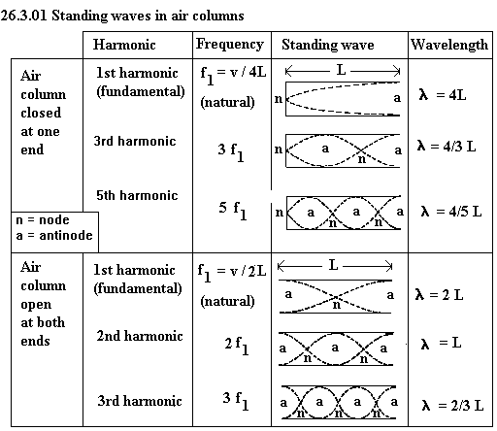

Slide 7
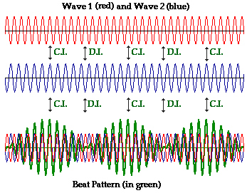
Beats
Two sound waves of slightly different frequencies can superpose to form beats.
The frequency of the beat is f_{beat} = |f_{A} – f_{B}|

Slide 8
The doppler effect
Imagine a duck floating on the surface of a pond, bouncing up and down.

Slide 9
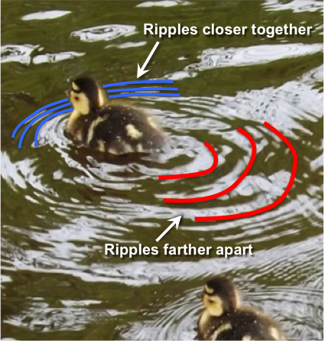
The doppler effect
Now imagine that duck swimming along the surface of a pond.
The waves in back are spread out.
- Larger λ
- Lower f
The waves in front get compacted.
- Smaller λ
- Higher f

Slide 10
The doppler effect

Slide 11
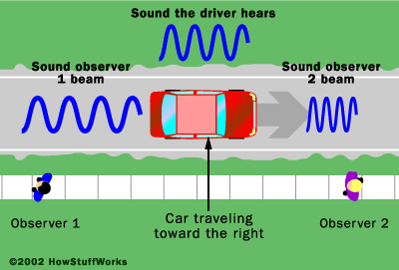
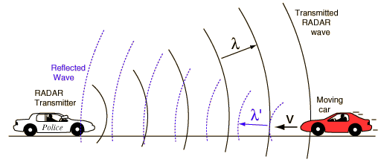
Doppler Effect
Doppler effect is the perceived pitch of a sound as 2 objects are moving together or apart, IE a cop siren chasing you down
Change in frequency of the sound from a moving object as the object moves past some observer.

Slide 12
Doppler Effect
Sonic Boom
A special case of the Doppler effect where the object generating the wave is actually moving faster than the wave.
This creates a “bow” wave of a super-wave that follows the moving object
Here is all this stuff together

Slide 13
Doppler Effect Equation
ƒ_{d} = ƒ_{s}( (v – v_{d}) / (v – v_{s}))
Where ƒ_{d} is the frequency perceived by the detector and ƒ_{s} is the frequency perceived by the source. V_{d} is the velocity of the detector relative to the source and v_{s} is the velocity of source relative to velocity of the wave.
I suggest you write down the formula’s on page 408 and try on 409.

Slide 14
Example 1
A 524 Hz siren is sounded from an ambulance travelling 28 m/s towards you. Assuming the speed of sound is 343 m/s, what frequency would you hear?

Slide 15
Example 2
The ambulance passes you and is now moving away from you at 28 m/s. The siren is still 524 Hz but now you decide to walk towards the ambulance at 1 m/s. What frequency do you hear? Recall the speed of sound is 343 m/s.

