Slide 1
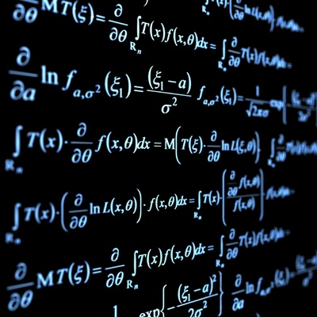
Math Review

Slide 2
Algebra
Algebra is the basic language of physics. If you don’t become fluent, you will struggle.
When working with equations ALWAYS solve for the unknown variable first, then substitute your known variables

Slide 3
Ex:
Solve for “a”→ F = ma
Solve for “t” → v = d/t
Solve for “c” → E = mc²
Solve for “d” → v² = u² +2ad

Slide 4
Ex:
1. Solve for “d” given that v = d/t
v = 36 m/s and t = 8.0 s
2. Solve for “m” given that F = ma
F = 150 N and a = 2.50 m/s²

Slide 5
Trigonometry
For right angle triangles we will use:
Pythagorean Theorem:
a² + b² = c²

Slide 6
Trigonometry
The trig relationships:
SOH – CAH – TOA
sin θ = opp/hyp
cos θ = adj/hyp
tan θ = opp/adj

Slide 7
Trigonometry
Ex: Solve the following triangle.
12 m
8 m

